Slide 1



NO2 Pollution Team Presentation
techUK February 2020
Presenter Name
G
Team Presentation

Slide 2
Hello!
Notes:
Good Afternoon and welcome to our team presentation.
So what are we here to talk to you about? Well…(run video)

Slide 3
//[Embedded Video]]//
Notes:
[Transcript] Climate change.
It is one of the biggest challenges facing the world today.
It requires global solutions, with politics, economics and individual efforts all playing there part.
But as we wake up to the climate crisis, the tech we use will be vital. Climate Change is an information issue that computers can help us win.
And there's one part of the climate change battle that tech can make a surprising difference.
Air pollution.
It kills 7 million people each year, takes trillions of pounds from the worlds economy, and for us in the UK, London air pollution takes 3 to 4 years off our life expectancy.
It is an invisible, silent issue that no one is talking about. But the simple fact remains that car exhausts kill more people than car accidents every year in the UK.
So how can tech help? When we think about the future of human transportation tech, the key isn’t self driving cars or smart motorways, it’s the tech we own in our smartphones.
We can use the information and tech in our smartphones to help battle climate change and air pollution in our cities. Today we’re going to talk to you about one of the ways we could help achieve this.

Slide 4

Lets talk about NO2 Pollution…
Notes:
So what are we trying to tackle? the Department of Environment, Food and Rural Affairs, (DEFRA) has linked Nitrogen Dioxide to 5900 premature deaths in London each year, and almost £20bn spent by the NHS each year treating wider emission related illness.
The largest producer of NO2, along with other emissions that have an adverse effect on human health is road transport^{2,} with road levels regularly exceeding a health detrimental 40ug m-3, and increasing yearly. Furthermore, according to NAEI, road transport accounts for almost one third of UK emissions.
But simultaneously against this , there is growing support among the UK population to reduce their personal carbon footprint and personally contribute to reducing climate change with almost 65% of people in a recent paper produced by the university of Cambridge prepared to take steps that could impact their daily lives to help reduce climate change.
Now for motorists, the currently offered steps have largely been to reduce the number of journeys or increase the uptake of public transport use. However, 60% of road emissions are still produced by private vehicle journeys, and account for 15% of the UK total emissions and this sector has shown little signs of decreasing so far. Therefore, reducing the total pollution emission these journeys account for, must also be considered as an option to be offered to commuters.
Therefore, our objective became to : Offer commuters a least polluting eco routing option on their daily journey, in a private vehicle.
Where: Eco-Routing is defined as the navigational route that allows a vehicle to emit to lowest qaunity of air pollunants to arrive at a given destination within a reasonable time period.

Slide 5
Discovery
Notes:
Now this objective has a wide number of implications and impacts on different groups and stakeholders, so we want to break it down into stories of various different people, to help understand what the requirements and user needs could be.
Now its fair to say these stories are hypothesis and assumptions rather than tested pure user needs, which can often seem like a dirty term in agile worlds – but it isn’t.
For our small team that can fail incredibly fast with almost no overhead costs, starting with assumptions allowed us to move fast into a position where we could start to deliver value, challenge assumptions and test ideas.What we did do however, was use Business Analysis research and use existing user data conducted from other teams, such as universities, car manufacturers and academic studies to make informed decisions.
This is an adaption to traditional agile theory that is starting to come through and is a point taken from one of the first industries days at Dell – that agile projects need to become more data driven from the get go by bringing in existing user needs and research from otherprojects and analysis into new projects earlier.
In future this evolution of agile is seen as a key step to being able to integrate AI into the methodology .
So lets introduce you to some of our users – for time during this presentation, I’ve reduced it down to three users.

Slide 6
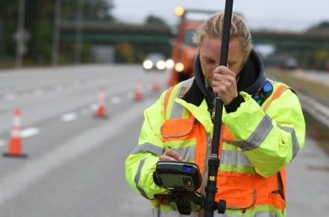
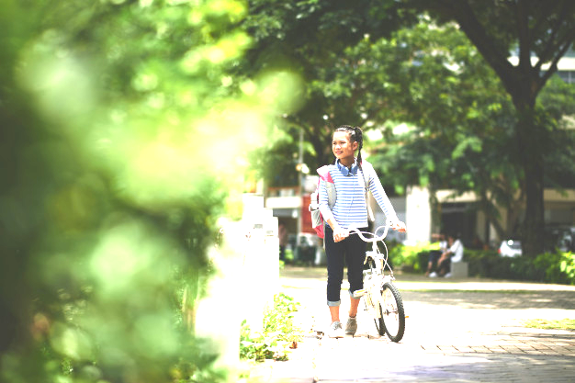
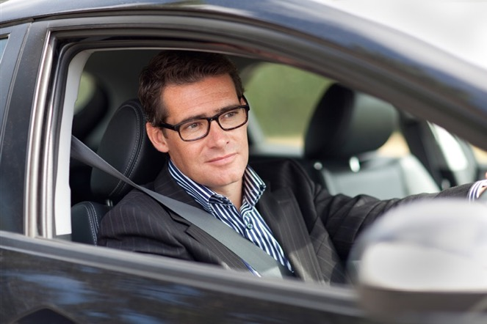
User Stories
Notes:
Carl is 41 years old, and works in London as a deputy head teacher at a local school. He commutes daily in his car, and takes him around 40 minutes to get to work. He has two daughters who love ballet and trampolining and they're already annoyingly passionate about the environment, he suspects from his school having several green friendly initiatives and tips that get shared with teachers and pupils every week in assembly.
His route varies day to day, using the satnav on his phone to find the best route and he often sees many of the children in his class walking or cycling in to the school gates as he gets closer, after there was a big push to encourage more eco friendly routes to school. He always feels a little guilty about driving when he see its; his wife bought him a new Nissan Qashqai for his birthday and whilst its brilliant for transporting overly excitable schoolchildren, there best friends and there friends puppies, its not so good for the environment.
He wants to help, but because of the long distance he lives from the school, he needs his car, and the only bus that goes anywhere near the school is always crammed full of school kids, none of which he can handle before at least two cups of coffee in the staff room first. He's happy to do something –within reason- to make his journey less harmful as adding a few extra minutes onto his journey, shouldn’t matter too much.
Rachel notices him pondering this as he drives past. Mr Gregory always looks funny when he’s concentrating she thinks to herself. She knows she’ll catch him up soon though and have another look. There’s always so much traffic down this road that she’ll be much faster than him on her bike. She hops back on her bike and starts peddling fast leaving her mum far behind. Just as well she peddles fast, its absolutely freezing, she can see her breath as she peddles. That’s nothing compared to the cars breath though. Out there exhaust there's always so much smoke when there on this road, sometimes she cant make out the cars number plates….
Helen can always make out the number plates. Its his job to be alert. She can read a number plate in three seconds from 50 meters away and send a phonetic message to her boss in Defra of the car reg in under 10 seconds. She enjoys her job and it always feels satisfying knowing shes helping. Shes less keen on being stood outside on this particular winters day. Unfortunatly apart from carrying her equipement, theres no cctv or pollution monitoring equipment that can help her measure the average No2 pollution from cars on this road. Its pretty important to do it aswell –this road is pretty close to the local primary school and its no2 pollution levels are almost three times the safe limit. Worryingly, it is estimated that across the capital 360 other primary schools in London are above legal pollution levels aswell. They really need more data and away to share this data with the wider world as theres only three of them on the team. Maybe one day they’ll be a way to get more data easily…one day.
Well ladies and gents, today we present our potential concept to meet these userrequirmeents. So this is our project aims:

Slide 7
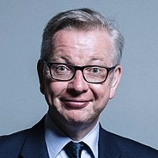
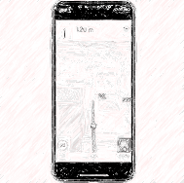
Concept
Most eco-friendly
route
Pollution
calculator
Our aim is to provide the most eco friendly route which does not overly increase journey time (i.e. <=10 mins)
Using the data collected from the eco-routes chosen we aim to;
- Provide informative feedback to users on their pollution stats etc.
- “Hive” tracking
- JACQU database
Estimate the level of pollution that the route will produce in comparison to other route options
(using data from sensors/DVLA database)
Collate data from
the eco routes
Notes:
This is our key concept….
To test if this concept was viable we did user research on this concept.

Slide 8
User research
1
50% use a satnav tool for their car journey
2
71% factor in additional time per car journey to arrive at their destination
3
90% rated time to work as the most important aspect of their car journey
4
23% rated environmental factors as the 2nd most important aspect.
5
82% would use an eco-route if they had the option
6
93% would prefer the feature to be an overlay on an existing navigation service
Notes:
Most common barriers that would stop users taking up the service;
- Not time efficient
- Ease of choice of route
- Not cost efficient
What would incentivize users to take up the service;
- Financial incentives (including; tax credits or public transport credits)
- Ease of access to information and routes
- Being shown the difference of the environmental damage between the eco-route and the fastest route
- If the app showed you how much improvement has been made on the environment/pollution levels
- Rewards system (i.e. go stats on Citymapper)
- Donations to charity

Slide 9
Prototype Design

Slide 10
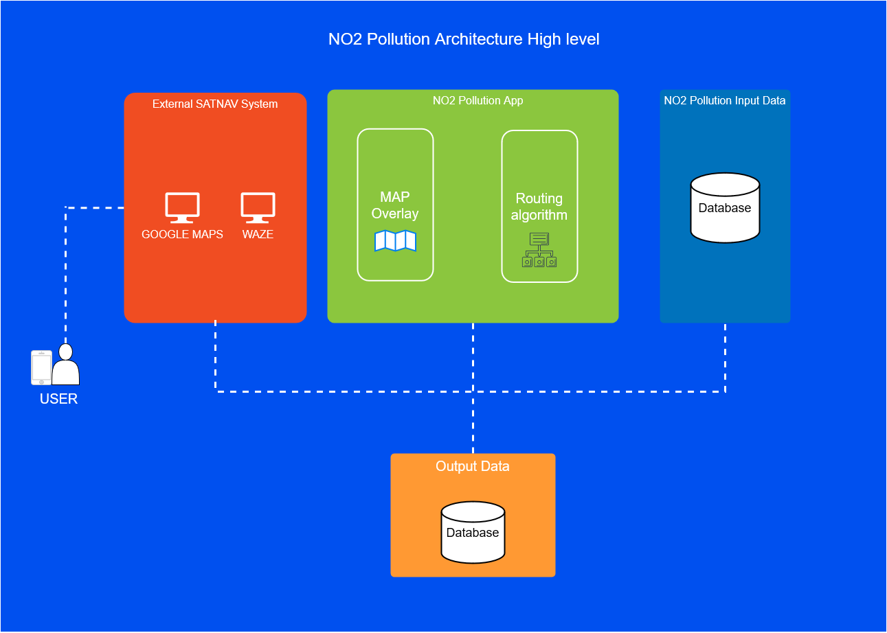
Architecture
Notes:
Map Overaly Service
Google allows for custom APIs using Java
Want this to be a trusted part of the google navigational service, as opposed to a custom product.
Will take in pollution data from our input database to overlay the map with pollution
Routing Algorithm
There’s quite a bit of literature on routing.
Based on shortest path techniques. We assign different roads different costs, based on our input data and information from Google. Our algorithm will then minimise this.
Can potentially just borrow Google’s own algorithm and just replace weights.
Route weighting based on factors such as number of vehicles nearby, nearby pollution, expected fuel consumption etc.
Feedback based on other people’s routes.
Will be implemented using software and will use Google processes.
Input Data
SQL Database. JAQU data
Defra Pollution Data sets
Past data
Output Data
Reporting service and also data export csvs.
Will output (anonymised) data on usage, expected reduction pollution. Can use this data to better predict data pollution levels based on routes etc.
Can be used by other sources to predict pollution levels in the future.
Users can also be provided for personal reports on their usage.

Slide 11
Alpha Concept

Slide 12
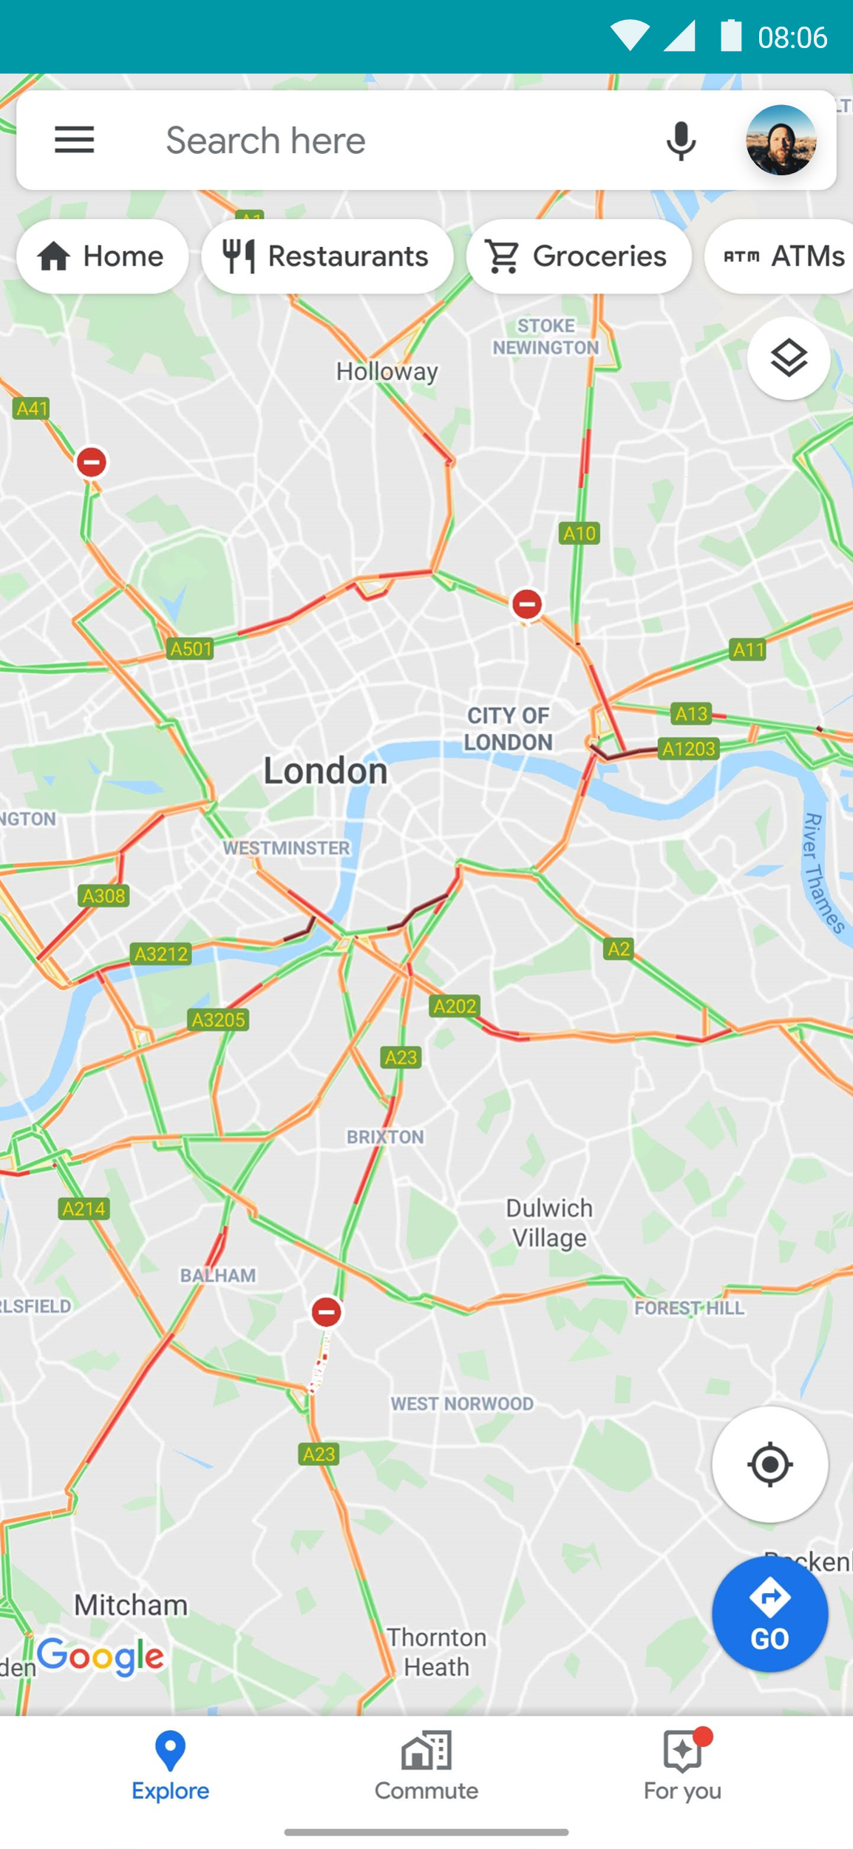
Join in!
ibm.biz/no2pollution
Notes:
Carl would do this….
This means Rachel sees less traffic and smoke when cars go past.
Helen gets much more data from her route

Slide 13
ibm.biz/no2pollution

Slide 14
ibm.biz/no2pollution
Let’s register our car.
1. Click the menu

Slide 15
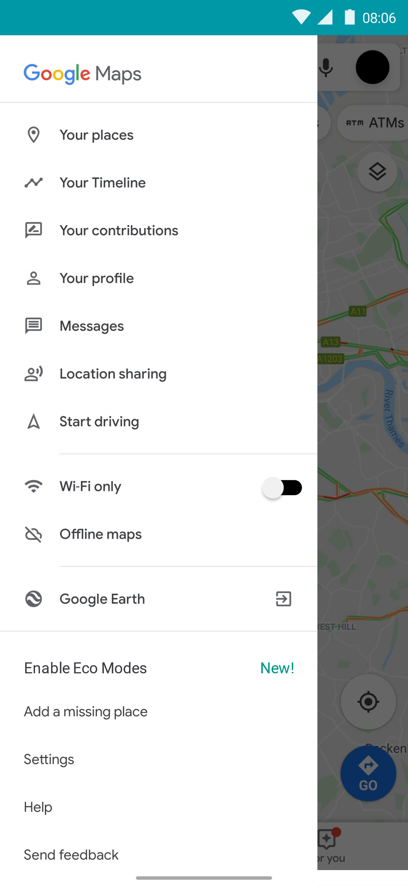
ibm.biz/no2pollution
Let’s register our car.
1. Click the menu
2. Tap “Enable Eco Modes”

Slide 16
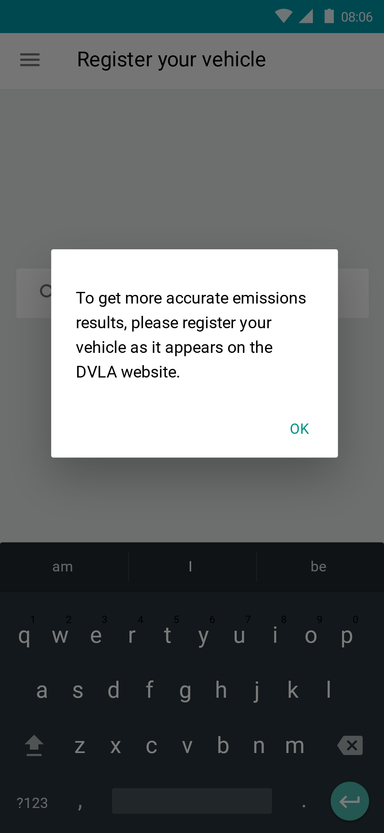
ibm.biz/no2pollution
Let’s register our car.
1. Click the menu
2. Tap “Enable Eco Modes”

Slide 17
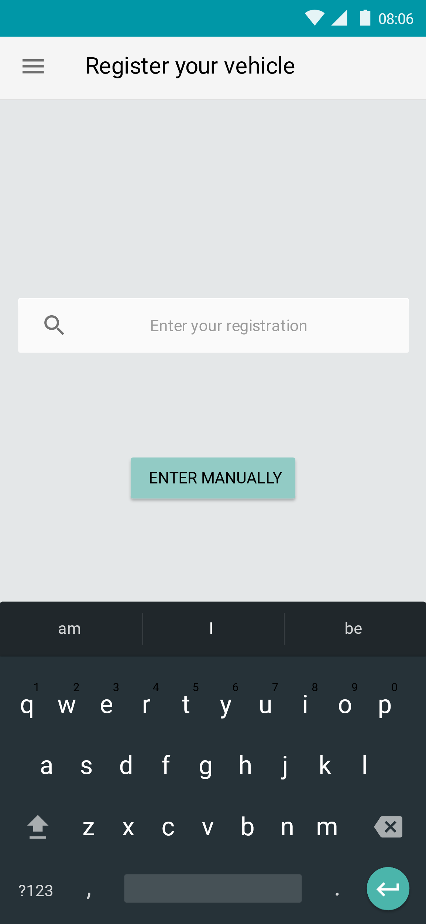
ibm.biz/no2pollution
Let’s register our car.
3. Tap the registration box
1. Click the menu
2. Tap “Enable Eco Modes”

Slide 18
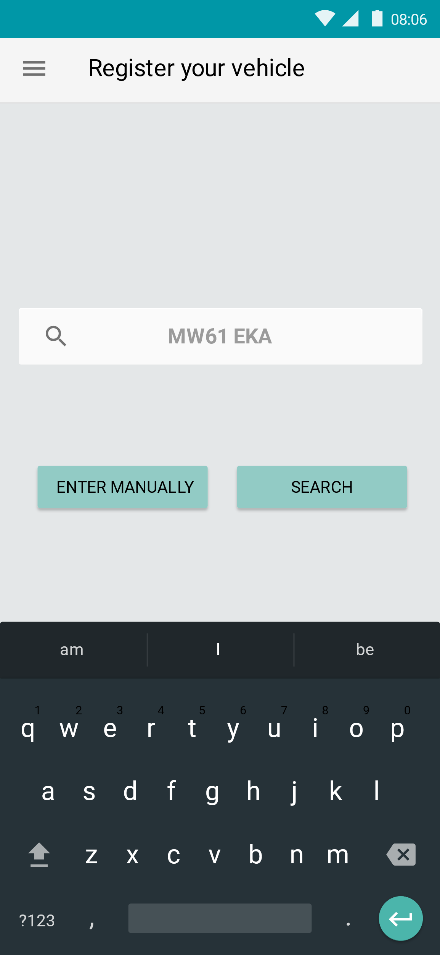
ibm.biz/no2pollution
Let’s register our car.
3. Tap the registration box
1. Click the menu
3. Search!
2. Tap “Enable Eco Modes”

Slide 19
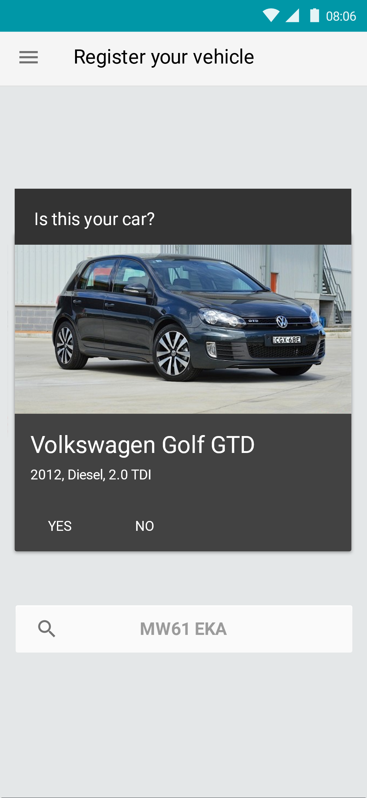
ibm.biz/no2pollution
Let’s register our car.

Slide 20
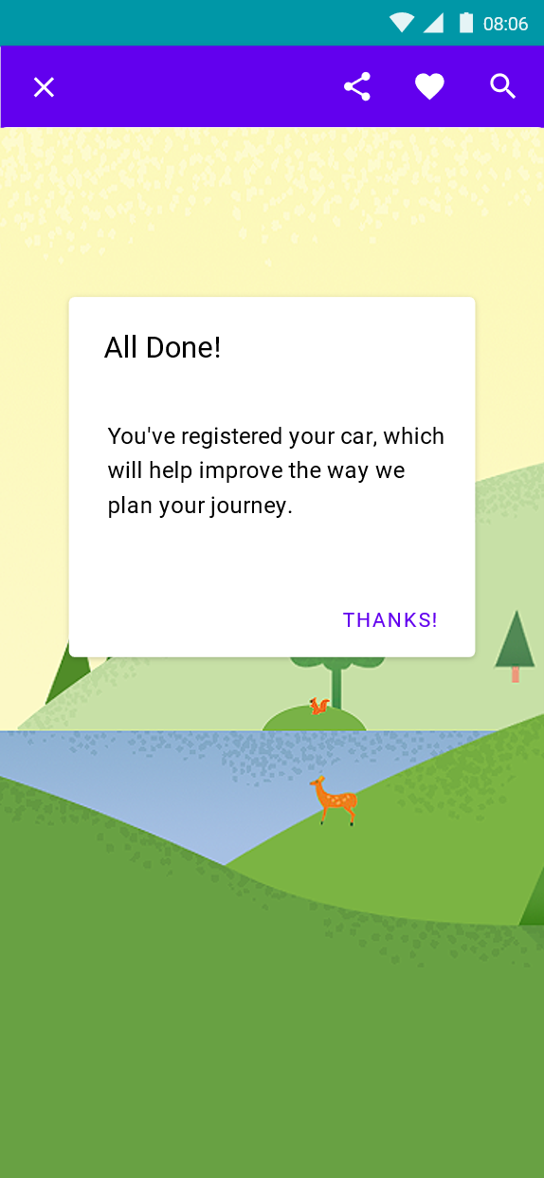
ibm.biz/no2pollution

Slide 21
Route planning
ibm.biz/no2pollution
Find your journey to work

Slide 22
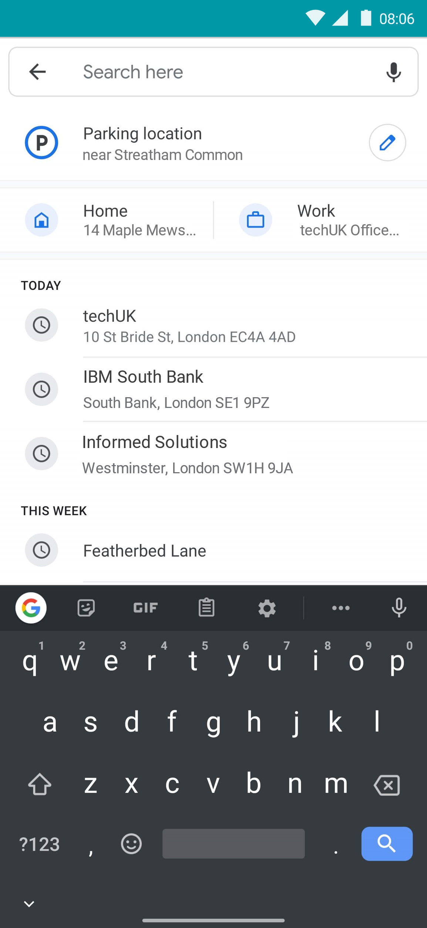
Route planning
ibm.biz/no2pollution
2. Pick your office
Find your journey to work

Slide 23
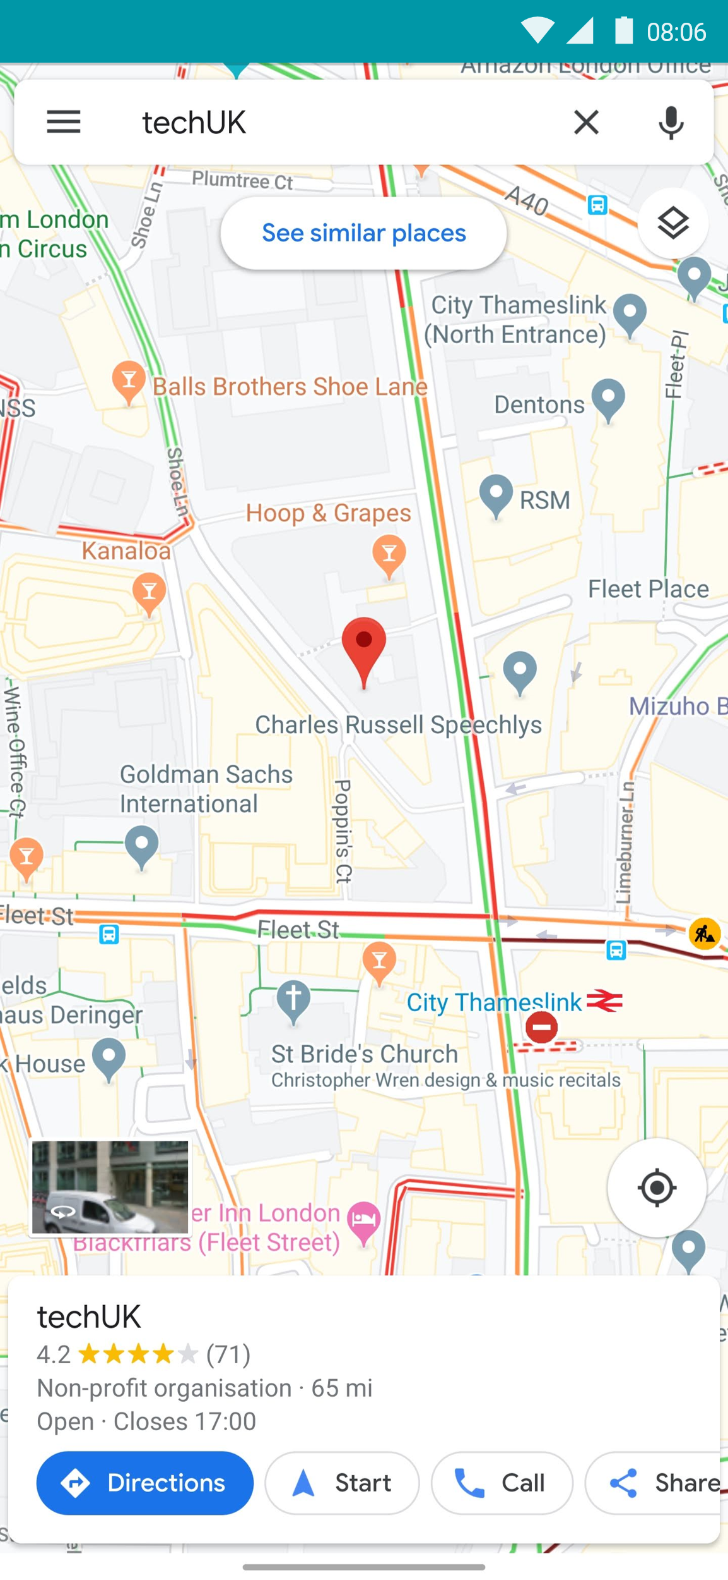
Route planning
ibm.biz/no2pollution
2. Pick your office
Find your journey to work
3. Get directions

Slide 24
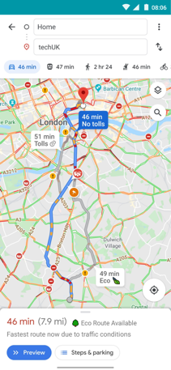
Route planning
ibm.biz/no2pollution
2. Pick your office
Find your journey to work
3. Get directions

Slide 25

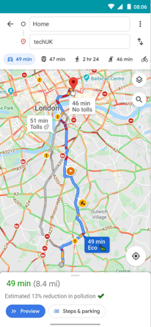
ibm.biz/no2pollution

Slide 26
ibm.biz/no2pollution

Slide 27
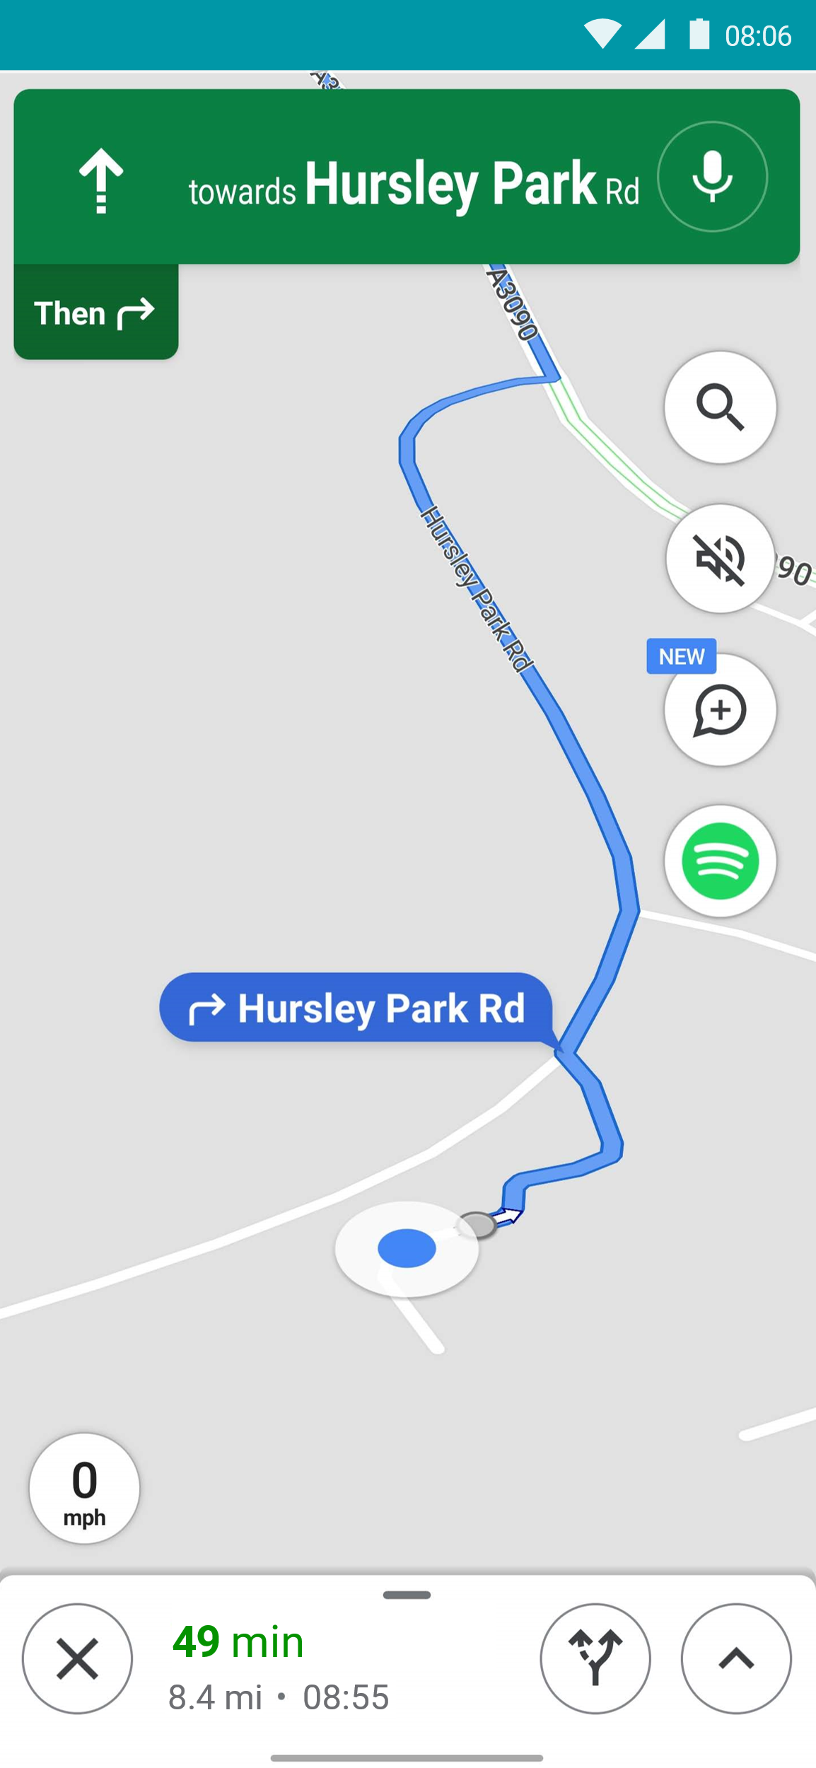
ibm.biz/no2pollution
Now you can just follow your route like normal.

Slide 28
ibm.biz/no2pollution
Now you can just follow your route like normal.
Tap anywhere on this screen to continue.

Slide 29
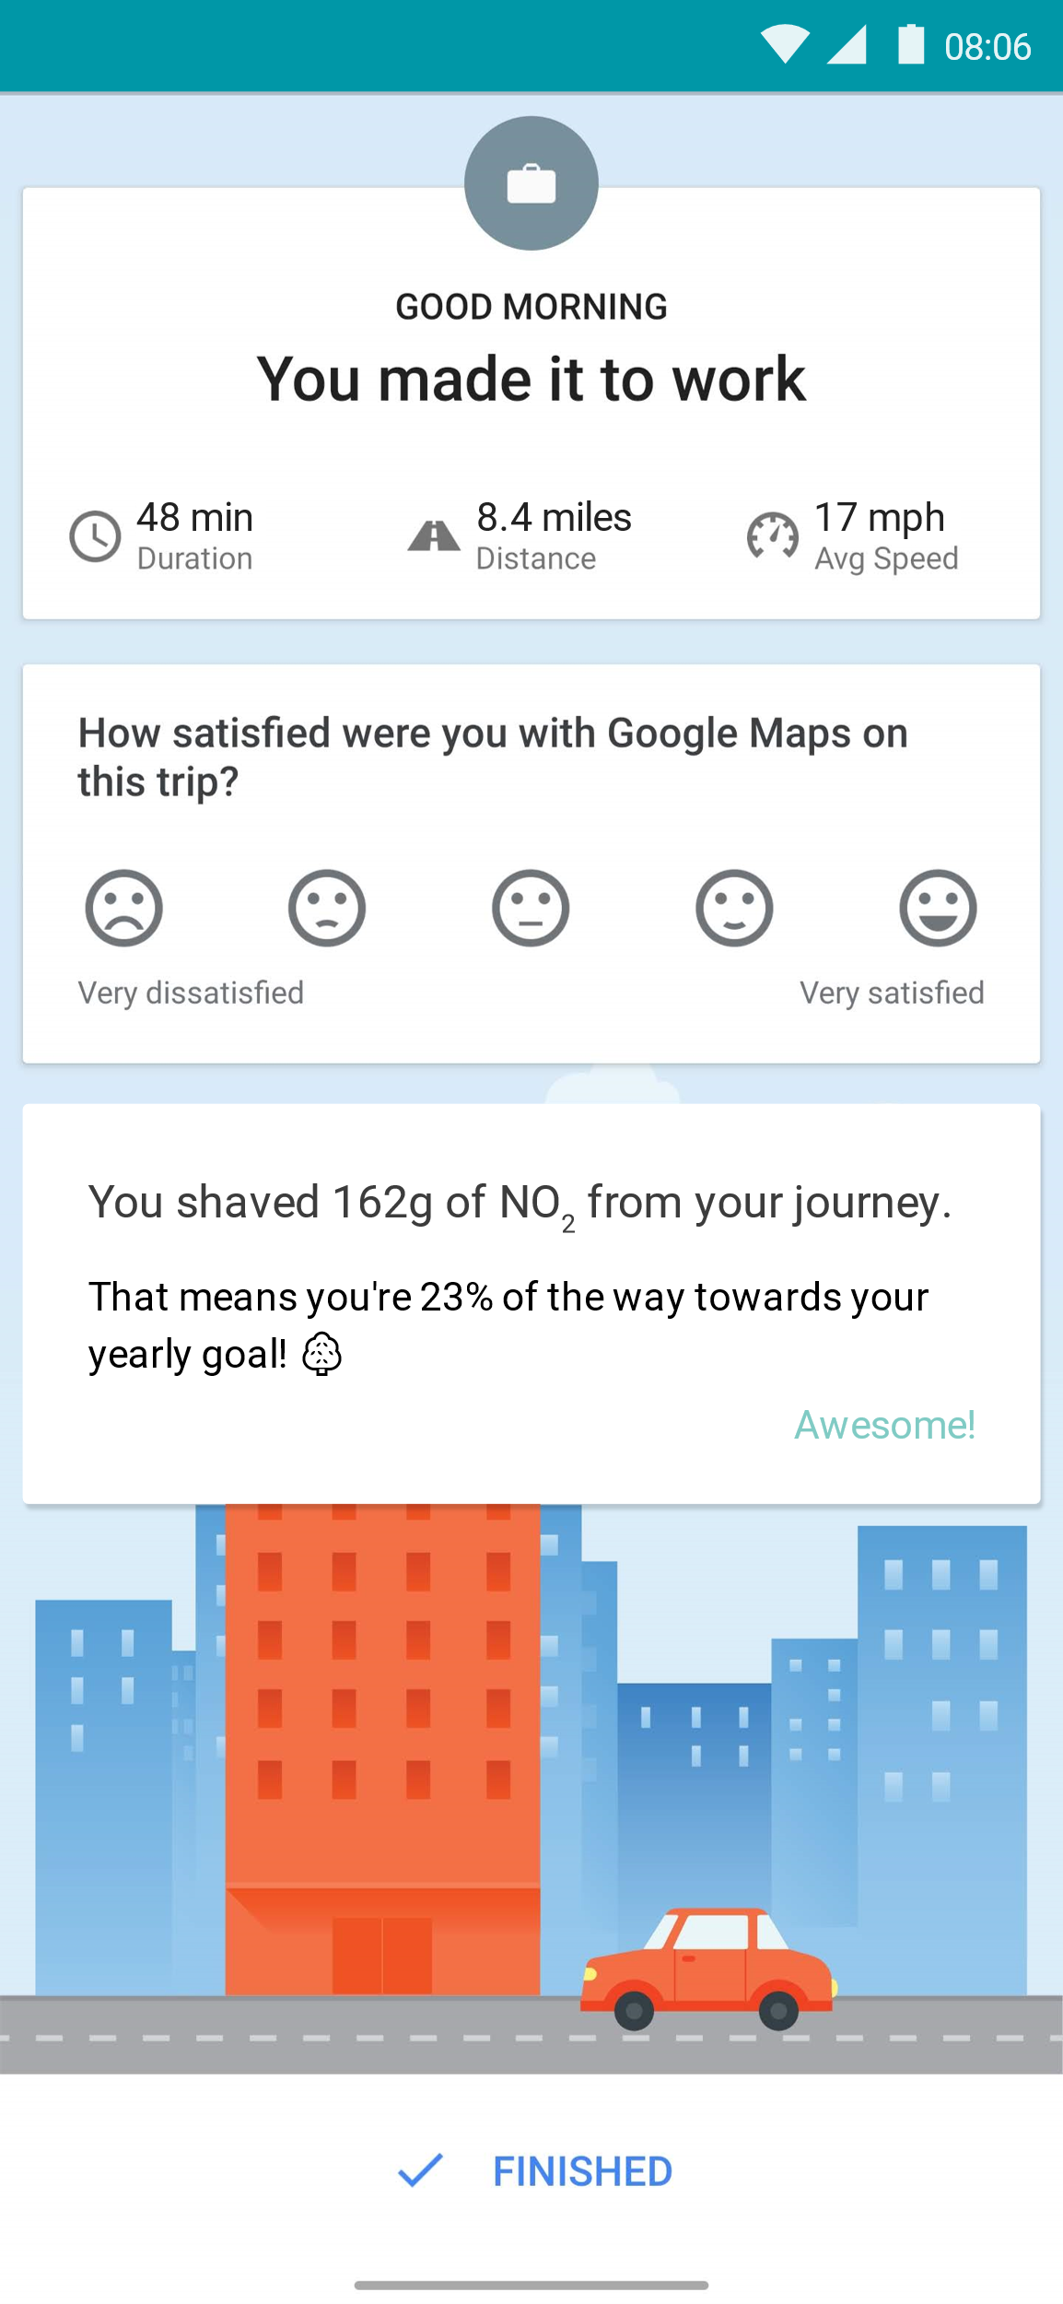
ibm.biz/no2pollution

Slide 30
ibm.biz/no2pollution
The final screen will summarise the effect you’ve had.

Slide 31
ibm.biz/no2pollution

Slide 32
User Testing
Notes:
Where we would take it next…..
What potential it has etc.
-This is becoming more and more achivements but this could give…….600,000 journeys producing 20% less pollution, this could save xgrams, which is x tons of pollution a day. This is equall to….
Just imagine what we could do

Slide 33
Feedback
Notes:
We showed this to

Slide 34
Project Next Steps
Notes:
Where we would take it next…..
What potential it has etc.
-This is becoming more and more achivements but this could give…….600,000 journeys producing 20% less pollution, this could save xgrams, which is x tons of pollution a day. This is equall to….
Just imagine what we could do

Slide 35
Looking Ahead
Notes:
Where we would take it next…..
What potential it has etc.
-This is becoming more and more achivements but this could give…….600,000 journeys producing 20% less pollution, this could save xgrams, which is x tons of pollution a day. This is equall to….
Just imagine what we could do

Slide 36

Thank You
NO2 Pollution
techUK February 2020
Presenter Name
GOV.UK Verify
GDS
G
Team Presentation

